Slide 1

Spring Boot Application with Schedulers
This presentation serves as a guide for integrating schedulers in Spring Boot applications. We'll cover the fundamental concepts, explore the advantages, and demonstrate with a sample project.

Slide 2


Introduction to Schedulers
1
Automation of Tasks
Schedulers in software empower developers to automate the execution of tasks at predetermined intervals. This eliminates the need for manual intervention, freeing up valuable time and resources.
2
Diverse Use Cases
Schedulers find wide applications in various scenarios, including system backups, sending notifications, database cleanup, and automated data synchronization. They are essential for maintaining system stability and ensuring smooth operations.
3
Reliable Execution
Schedulers guarantee the consistent and timely execution of tasks, regardless of user interaction. This reliability is crucial for mission-critical operations where missed deadlines can have significant consequences.

Slide 3
Why Use Schedulers in Applications?
Enhanced Automation
Resource Optimization
Improved User Experience
Schedulers automate repetitive tasks, reducing manual effort and minimizing human error. This streamlines workflows and improves operational efficiency.
By offloading tasks to background processes, schedulers optimize resource utilization. This frees up the main application thread for handling user requests, ensuring a responsive and efficient user experience.
Schedulers can execute tasks without interrupting the user's interaction with the application. This results in a seamless experience, improving user satisfaction and productivity.

Slide 4
Integrating Schedulers in a Spring Boot Application
1
Enabling Scheduling
Spring Boot offers seamless integration with scheduling mechanisms. The @EnableScheduling annotation enables scheduling capabilities within your application.
2
Defining Scheduled Tasks
The @Scheduled annotation marks methods as scheduled tasks. You can define the execution frequency using cron expressions or predefined intervals.
3
Configuring Schedule Timings
Cron expressions provide a flexible way to define complex schedules, allowing for precise control over task execution times.

Slide 5
Sample Project Overview
Entities
Repositories
Services
The project incorporates entities such as Task, which stores information like ID, name, status, and other relevant details.
Repositories are responsible for handling CRUD operations on the entities, providing access to data persistence.
Services encapsulate business logic, handling operations related to task creation, modification, and status updates.
Controllers
Scheduler
Controllers handle incoming HTTP requests and map them to appropriate service methods, providing an API for interacting with the application.
The scheduler component executes scheduled tasks, such as periodically updating task statuses or performing database cleanup.

Slide 6





Scheduling Techniques in Spring Boot
Fixed Rate Scheduling
Fixed rate scheduling executes tasks at fixed intervals, irrespective of the completion time of the previous task. This approach ensures consistent execution frequency.
Fixed Delay Scheduling
Fixed delay scheduling delays the execution of the next task until the previous one completes. This ensures that tasks are not executed concurrently.
Initial Delay Scheduling
Initial delay scheduling introduces a delay before the first execution, followed by fixed rate or delay scheduling. This allows for a staggered start.

Slide 7
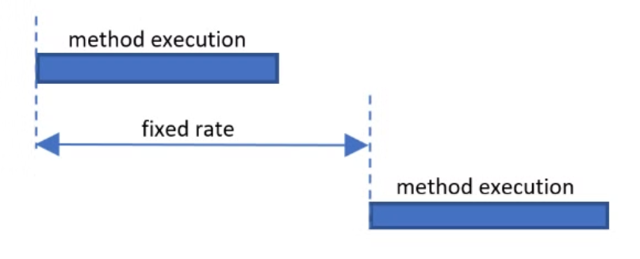

Fixed Rate VS Fixed Delay
The task is executed at a fixed interval, measured from the start of the previous execution.
The task is executed with a delay after the completion of the previous execution.
Example: If a task is scheduled with fixedRate = 5000 (5 seconds), it will start every 5 seconds, even if the previous task hasn't finished yet (which could lead to overlapping executions if the task takes longer than 5 seconds).
Example: If a task is scheduled with fixedDelay = 5000 (5 seconds), it will wait 5 seconds after the previous execution completes before starting the next one.

Slide 8

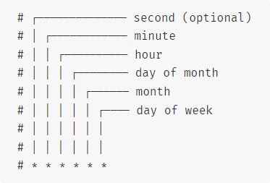
Advanced Scheduling Techniques
Using Cron Expressions
Cron expressions are a powerful way to schedule tasks with more complex timing requirements.
They allow you to specify a specific time, date, or recurring pattern for task execution.
This can be useful for scheduling tasks at specific intervals, on certain days of the week, or even at specific times of the day.

Slide 9


Best Practices and Considerations
1
Managing Long-Running Tasks
For tasks that might take extended periods, consider using asynchronous execution mechanisms to avoid blocking the main thread and ensure application responsiveness.
2
Exception Handling
Implement robust exception handling mechanisms to gracefully manage errors during task execution, preventing application crashes and ensuring stability.
3
Avoiding Heavy Operations
Minimize heavy operations on the main thread to prevent performance degradation. Offload intensive tasks to background threads or dedicated worker processes.
4
Performance Impact
Carefully consider the impact of scheduling on application performance. Optimize tasks and schedules to minimize resource consumption and ensure optimal throughput.

Slide 10



Conclusion
Automation and Efficiency
Spring Boot Integration
Sample Project Demonstration
Schedulers play a crucial role in automating repetitive tasks, enhancing application efficiency, and streamlining workflows.
Spring Boot provides a robust and convenient framework for integrating scheduling mechanisms into your applications.
The sample project showcased the practical application of scheduling concepts, providing a hands-on understanding of how to implement scheduled tasks.

